Slide 1
Traceroute Project Guide
CS 168 @ UC Berkeley
Slides credit: Sylvia Ratnasamy, Rob Shakir, Peyrin Kao
Last updated: Fall 2024
Notes:
Slides template credit: Josh Hug, Lisa Yan

Slide 2
Protocols
1. Networking Background
1.1. Protocols 1.2. Building the Internet 1.3. Properties of the Internet 1.4. Higher Layers 1.5. Headers 1.6. Multiple Headers 1.7. Demultiplexing 1.8. Demultiplexing with Ports
2. Introducing Traceroute
2.1. Time-to-Live (TTL) 2.2. Exploiting TTL 2.3. Repeated Probing 2.4. Unreachable Ports
Traceroute Project Guide, CS 168

Slide 3
Protocols
The Internet is all about designing protocols.
Protocol: A specification on how to communicate.
Syntax: Format of messages. What do the 1s and 0s mean?
Semantics: What actions should I take in response to certain messages?
Example: Protocol for asking a question in lecture?
Raise your hand.
Wait for speaker to call on you.
Ask your question after speaker calls on you.
If speaker doesn't see you after some time, say "Excuse me!"

Slide 4
Building the Internet
1. Networking Background
1.1. Protocols 1.2. Building the Internet 1.3. Properties of the Internet 1.4. Higher Layers 1.5. Headers 1.6. Multiple Headers 1.7. Demultiplexing 1.8. Demultiplexing with Ports
2. Introducing Traceroute
2.1. Time-to-Live (TTL) 2.2. Exploiting TTL 2.3. Repeated Probing 2.4. Unreachable Ports
Traceroute Project Guide, CS 168

Slide 5
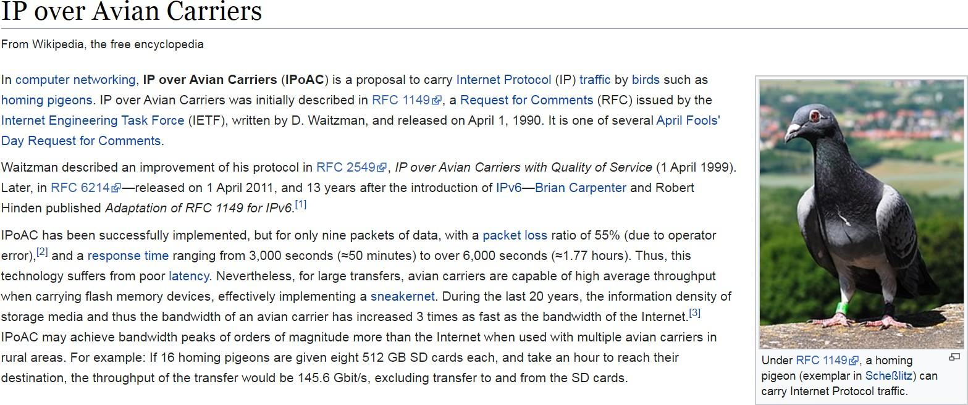
Layer 1 – Moving Bits Across Space
We need some physical technology to move data across space.
Postal analogy: Mailman, Pony Express, carrier pigeon, etc.
Are pigeons faster than the Internet?

Slide 6


Layer 1 – Moving Bits Across Space
We need some physical technology to move bits across space.
Voltages on electrical wire.
Light signals on optical fiber.
Wireless radio waves.
Won't go into detail in this class.

Slide 7
Layer 2 – Local Networks
Postal analogy: Use our physical technology to connect everybody in the local town.
Forming a local network:
Use physical technology to create a link between machines.
Use links to connect all machines in a local area.
Machines can exchange packets: A group of bits representing a message.

Slide 8
Layer 3 – Connecting Local Networks
Postal analogy: How do we connect houses from different towns?
Adding new links between every pair of houses is inefficient.

Slide 9
Layer 3 – Connecting Local Networks
Postal analogy: How do we connect houses from different towns?
Solution: Introduce a post office in each town.
Just connect the two post offices.

Slide 10
Layer 3 – Connecting Local Networks
To send a letter to the other town:
You send the packet to...
Your local post office, which sends the packet to...
The other town's post office, which sends the packet to...
The final destination.

Slide 11
Properties of the Internet
1. Networking Background
1.1. Protocols 1.2. Building the Internet 1.3. Properties of the Internet 1.4. Higher Layers 1.5. Headers 1.6. Multiple Headers 1.7. Demultiplexing 1.8. Demultiplexing with Ports
2. Introducing Traceroute
2.1. Time-to-Live (TTL) 2.2. Exploiting TTL 2.3. Repeated Probing 2.4. Unreachable Ports
Traceroute Project Guide, CS 168

Slide 12
Network of Networks
With enough post offices, we can connect all the towns in the world!
The Internet is a network of networks.
Each operator runs its own local network.
The local networks connect to each other to form the Internet.

Slide 13
Hosts vs. Switches
End hosts are the machines communicating over the Internet.
Analogy: Houses.
Examples: Your laptop, your phone, Google's server.
Switches (aka routers) receive packets and forward them toward their destination.
Analogy: Post offices.

Slide 14
Layers of Abstraction
Modularity: In our design, we decomposed the system into layers of abstraction.
Each layer relies on services from the layer below.
Each layer provides services to the layer above.
Layer 3:
Internet
Connect many local networks to form the Internet.
Layer 2:
Link
Create links in a local network.
Layer 1:
Physical
Move bits across space.

Slide 15
Global Delivery at Layer 3
A packet can take multiple hops to reach its destination.
Each router needs to forward the packet closer to its destination.

Slide 16
Layer 3 is Best-Effort
Layer 3 offers a best-effort service model.
Packets are limited in size.
Packets could get lost, reordered, corrupted, etc.
The network will try its best to deliver your packet, but no guarantee.
The network won't tell you if the delivery failed.
We need to build more layers if we want to guarantee packet delivery.

Slide 17
Higher Layers
1. Networking Background
1.1. Protocols 1.2. Building the Internet 1.3. Properties of the Internet 1.4. Higher Layers 1.5. Headers 1.6. Multiple Headers 1.7. Demultiplexing 1.8. Demultiplexing with Ports
2. Introducing Traceroute
2.1. Time-to-Live (TTL) 2.2. Exploiting TTL 2.3. Repeated Probing 2.4. Unreachable Ports
Traceroute Project Guide, CS 168

Slide 18
Layer 4 – Reliability
Transport layer builds on top of Layer 3 (global packet delivery).
Adds extra mechanisms (e.g. re-sending lost packets) for reliable packet delivery.
Splits up large data into packets to send them. Reassembles received packets.
Instead of individual packets, can think about flows (aka connections): A stream of packets exchanged between two endpoints.
Layer 4:
Transport
Reliably deliver packets, forming connections.
Layer 3:
Internet
Connect many local networks to form the Internet.
Layer 2:
Link
Create links in a local network.
Layer 1:
Physical
Move bits across space.

Slide 19
Layer 7 – Application
Application layer builds services (e.g. websites, video streaming) on top of Layer 4.
This design lets us build different services, all on the same infrastructure.
Note: Layers 5 and 6 are now obsolete.
Layer 7:
Application
Implement services on top of the Internet infrastructure.
Layer 4:
Transport
Reliably deliver packets, forming connections.
Layer 3:
Internet
Connect many local networks to form the Internet.
Layer 2:
Link
Create links in a local network.
Layer 1:
Physical
Move bits across space.

Slide 20
Headers
1. Networking Background
1.1. Protocols 1.2. Building the Internet 1.3. Properties of the Internet 1.4. Higher Layers 1.5. Headers 1.6. Multiple Headers 1.7. Demultiplexing 1.8. Demultiplexing with Ports
2. Introducing Traceroute
2.1. Time-to-Live (TTL) 2.2. Exploiting TTL 2.3. Repeated Probing 2.4. Unreachable Ports
Traceroute Project Guide, CS 168

Slide 21
Why Do We Need Headers?
Suppose A wants to send an image to B.
A forms a packet with the bits of the image. (May need to split image into multiple packets.)
A sends the packet to the next router.
The router has no idea what these bits are for!
The packet needs some extra metadata, to tell us what to do with the packet.
Analogy: Letter needs to be put in an envelope. Envelope describes what to do with the letter.
01000111100010101001
???
A
R1
R2
R3
B
Sender
Router
Router
Router
Recipient

Slide 22
Common Header Fields
The packet header contains metadata describing how the data should be sent.
Some common fields in a header:
Destination address: Required to deliver the packet.
Source address: Useful if the recipient wants to send replies back.
The actual data in the packet is called the payload.
From: A
To: B
01000111100010101001
Headers
Payload
A
R1
R2
R3
B
Sender
Router
Router
Router
Recipient

Slide 23
Headers are Standardized
Everybody needs to agree on the format of the header.
"First 8 bits are the source, next 8 bits are the destination..."
If we use a different format, others won't understand the header.
From: A
To: B
01000111100010101001
Headers
Payload
A
R1
R2
R3
B
Sender
Router
Router
Router
Recipient

Slide 24
Multiple Headers
1. Networking Background
1.1. Protocols 1.2. Building the Internet 1.3. Properties of the Internet 1.4. Higher Layers 1.5. Headers 1.6. Multiple Headers 1.7. Demultiplexing 1.8. Demultiplexing with Ports
2. Introducing Traceroute
2.1. Time-to-Live (TTL) 2.2. Exploiting TTL 2.3. Repeated Probing 2.4. Unreachable Ports
Traceroute Project Guide, CS 168

Slide 25
Postal Analogy
CEO Alice wants to send a message to CEO Bob.
Alice writes a letter.
CEO
"Your days are numbered."
CEO
Secretary
Secretary
Mail Room
Mail Room

Slide 26
Postal Analogy
Alice passes the letter down to her secretary.
Her secretary puts the letter in an envelope.
CEO
CEO
From: Alice, To: Bob
Secretary
"Your days are numbered."
Secretary
Mail Room
Mail Room

Slide 27
Postal Analogy
Her secretary passes the letter down to the mailman.
The mailman puts the envelope in a box.
CEO
CEO
Secretary
Secretary
From: 123 Alice St
To: 456 Bob St
Mail Room
From: Alice, To: Bob
Mail Room
"Your days are numbered."

Slide 28
Postal Analogy
The packet travels through the postal system, to Bob's building.
CEO
CEO
Secretary
Secretary
From: 123 Alice St
To: 456 Bob St
Mail Room
From: Alice, To: Bob
Mail Room
"Your days are numbered."

Slide 29
Postal Analogy
The mailman unwraps the box, revealing the envelope inside.
The mailman passes the envelope up to the secretary.
CEO
CEO
From: Alice, To: Bob
Secretary
"Your days are numbered."
Secretary
Mail Room
Mail Room

Slide 30
Postal Analogy
The secretary unwraps the envelope, revealing the letter inside.
The secretary passes the letter up to Bob.
CEO
"Your days are numbered."
CEO
Secretary
Secretary
Mail Room
Mail Room

Slide 31
Postal Analogy
As we move to lower layers, we wrap additional headers around the packet.
As we move to higher layers, we peel off headers, revealing the inner headers.
CEO
CEO
Secretary
Secretary
Mail Room
Mail Room
From: 123 Alice St
To: 456 Bob St
From: Alice, To: Bob
From: Alice, To: Bob
"Your days are numbered."
"Your days are numbered."
"Your days are numbered."

Slide 32
Postal Analogy
Each person only cares about the headers at their layer.
Mailman reads the green header, ignores all the payload inside.
Each person communicates with its peers at the same layer.
Alice's secretary writes the blue header, for Bob's secretary to read.
A protocol at a specific layer only makes sense to people at that layer.
CEO
CEO
From: 123 Alice St
To: 456 Bob St
Mailman only cares about this.
Secretary
Secretary
From: Alice, To: Bob
Secretary only cares about this.
"Your days are numbered."
CEO only cares about this.
Mail Room
Mail Room

Slide 33
Addressing at Different Layers
Notice: Different layers use different addressing schemes.
Inside a building: "413 Soda Hall."
In the postal system: "2551 Hearst Ave, Berkeley, CA."
From: 123 Alice St
To: 456 Bob St
These addresses make sense to the mailman.
From: Alice, To: Bob
These names make sense to the secretary.
"Your days are numbered."

Slide 34
Multiple Headers
As we move to lower layers, we wrap additional headers around the packet.
Layer 7:
Application
Application
Transport
Converted to bits and transmitted.
Transport
Layer 4:
Layer 2 Header
Layer 3 Header
Layer 3:
Internet
Internet
Layer 4 Header
Link
"Your days are numbered."
Link
Layer 2:
Layer 1:
Physical
Physical

Slide 35
Multiple Headers
As we move to higher layers, we peel off headers, revealing the inner headers.
Layer 7:
Application
Application
Transport
Bits received over wire.
Transport
Layer 4:
Layer 2 Header
Layer 3 Header
Layer 3:
Internet
Internet
Layer 4 Header
Link
"Your days are numbered."
Link
Layer 2:
Layer 1:
Physical
Physical

Slide 36
Multiple Headers
Peers at the same layer communicate with each other using the header at that layer.
Application
HTTP, DNS
Application
Layer 7:
Transport
TCP, UDP
Transport
Layer 4:
Internet
IP
Internet
Layer 3:
Link
Ethernet
Link
Layer 2:
Physical
Physical wire
Physical
Layer 1:

Slide 37
Demultiplexing
1. Networking Background
1.1. Protocols 1.2. Building the Internet 1.3. Properties of the Internet 1.4. Higher Layers 1.5. Headers 1.6. Multiple Headers 1.7. Demultiplexing 1.8. Demultiplexing with Ports
2. Introducing Traceroute
2.1. Time-to-Live (TTL) 2.2. Exploiting TTL 2.3. Repeated Probing 2.4. Unreachable Ports
Traceroute Project Guide, CS 168

Slide 38
Protocols at Different Internet Layers
Multiple protocols exist at each layer.
End hosts can agree on the L4 and L7 protocols they want to use.
Routers on each link can agree on the L1 and L2 protocols they want to use.
Layer 7:
Application
SMTP
HTTP
UDP
NTP
Layer 4:
Transport
TCP
UDP
Layer 3:
Internet
IP
Layer 2:
Link
FDDI
Ethernet
Wi-Fi
Point-to-Point
Layer 1:
Physical
Optical
Copper Wire
Radio Waves
Telephone Line

Slide 39
Demultiplexing
When you receive a packet, you pass it up the stack, to higher-layer protocols.
How did IP know to pass up to TCP, not UDP?
How did TCP know to pass up to HTTP, not SMTP?
Layer 7:
Application
SMTP
HTTP
DNS
NTP
Which way?
Layer 4:
Transport
TCP
UDP
Which way?
Layer 3:
Internet
IP
Layer 2:
Link
FDDI
Ethernet
Wi-Fi
Point-to-Point
Layer 1:
Physical
Optical
Copper Wire
Radio Waves
Telephone Line

Slide 40
Demultiplexing at Layer 3
Demultiplexing:
Add a new header field that tells us what the next (higher) layer protocol is.
Allows the IP code to pass the rest of the packet to the appropriate L4 code.
From: Alice's computer
To: Bob's computer
Next layer is TCP.
From: Alice's computer
To: Bob's computer
Next layer is UDP.
Layer 4 headers
Layer 4 headers
"Potato."
"Potato."
TCP
UDP
Which way?
IP

Slide 41
Demultiplexing with Ports
1. Networking Background
1.1. Protocols 1.2. Building the Internet 1.3. Properties of the Internet 1.4. Higher Layers 1.5. Headers 1.6. Multiple Headers 1.7. Demultiplexing 1.8. Demultiplexing with Ports
2. Introducing Traceroute
2.1. Time-to-Live (TTL) 2.2. Exploiting TTL 2.3. Repeated Probing 2.4. Unreachable Ports
Traceroute Project Guide, CS 168

Slide 42
Demultiplexing at Layer 4
Demultiplexing also works at Layer 4.
Each running application on your computer is associated with a port number.
When L4 receives a packet, it uses the port number to pass the packet to the corresponding application.
More specifically, each open connection on your computer.
From: Port 80
To: Port 40000
From: Port 587
To: Port 50000
From: Port 194
To: Port 60000
Here's that YouTube video you asked for.
Stop watching YouTube and answer your email.
you're fired!!!
Firefox
(40000)
Email
(50000)
Slack
(60000)
TCP
Which way?

Slide 43
Ports at Layer 4
Port numbers help us distinguish between applications on the same computer.
IP address (Layer 3) for all the applications is the same.
But each connection is associated with a different port number.
Analogy: Room numbers.
You and your housemate both have the same street address.
If someone sends a letter to your house, who is it for?
Distinguish by assigning room numbers to each housemate.
From: YouTube server
To: Bob's computer
Next layer is TCP.
Demultiplex: Which L4 protocol?
From: Port 80
To: Port 40000
Demultiplex: Which L7 application?
[cat video]

Slide 44
Ports at Layer 4
Both end hosts in a connection have a port number.
A private client (e.g. your computer) can use a randomly-generated port number.
A public server (e.g. YouTube) must use a fixed, well-known port number.
Analogy: Room numbers.
Pick any number for your bedroom. No one cares.
Public room numbers (e.g. in Soda Hall) must be fixed and well-known.
From: Bob's computer
To: YouTube server
Next layer is TCP.
From: YouTube server
To: Bob's computer
Next layer is TCP.
Incoming reply: YouTube replies to Bob's chosen port. Bob's computer passes the packet to the correct application (Firefox, not Slack).
Outgoing packet: Bob picks a random port number, but sends to YouTube's fixed port, 80.
From: Port 40000
To: Port 80
From: Port 80
To: Port 40000
give me cat video
[cat video]

Slide 45
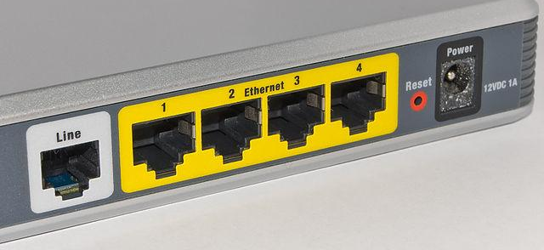
Caution – Terminology Conflict
In networking, there are two different things, both called "ports."
If it's unclear, we will specify "logical port" or "physical port."
From: Port 80
To: Port 40000
[cat video]
Logical port: A number identifying an application. Exists in software.
Physical port: The hole you plug a cable into. Exists in hardware.
Notes:
https://commons.wikimedia.org/wiki/File:Adsl_connections.jpg

Slide 46
Time-to-Live
1. Networking Background
1.1. Protocols 1.2. Building the Internet 1.3. Properties of the Internet 1.4. Higher Layers 1.5. Headers 1.6. Multiple Headers 1.7. Demultiplexing 1.8. Demultiplexing with Ports
2. Introducing Traceroute
2.1. Time-to-Live (TTL) 2.2. Exploiting TTL 2.3. Repeated Probing 2.4. Unreachable Ports
Under construction, should be done by September 1, 2024 or so.
Traceroute Project Guide, CS 168

